Slide 1
Evaluation
Wen-Cheng Lin
Department of Medical Informatics
Tzu Chi University

Slide 2
Measure Performance
How good is the learned hypothesis (model)?
What are the factors that can reveal the success of a hypothesis?
Depands on task

Slide 3
Classification Evaluation Metrics
Confusion matrix
Accuracy
Precision
Recall, Sensitivity
F score
Precision-Recall or PR curve
Specificity
ROC (Receiver Operating Characteristics) curve, Area Under Curve (AUC)

Slide 4
Confusion Matrix
A matrix that provides detailed correct and incorrect classifications for each class.
Predicted class
Predicted class
 | c1 | c2 | C3
C1 | 12 | 0 | 1
C2 | 0 | 10 | 8
C3 | 2 | 0 | 15
 | ture | false
True | Ture Positives TP | False Negatives FN
False | False Positives FP | True Negatives TN
Actul class
Actul class

Slide 5
Classification Accuracy
$$\frac{number of correct predictions}{Total number of predictions made}=\frac{TP+TN}{TP+FP+TN+FN}$$
Not a good metric if classes are imbalanced
If 95% of people don’t have cancer, 5% of people have cancer.
  A hypothesis that always guess “No cancer” has a 95% accuracy, but it is useless.

Slide 6


Precision, Recall, and F Score
Precision
  Percentage of actual positive instances out of the total predicted positive instances.
Recall/Sensitivity/True Positive Rate
  Percentage of actual positive instances out of the total actual positive instances.
$$\frac{TP}{TP+FP}$$
$$\frac{TP}{TP+FN}$$

Slide 7
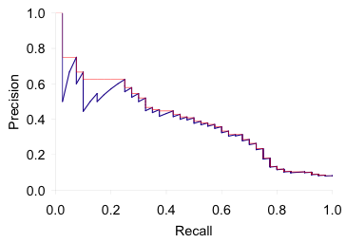
Precision/recall tradeoff
You can increase recall by guessing more positive instances.
It’s easy to get high precision for very low recall.
PR curve
  The curve between precision and recall for various threshold values.

Slide 8

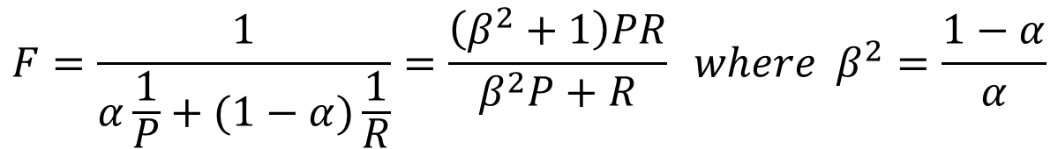
F Score
F allows us to trade off precision against recall.
  F₁: β = 1 or α = 0.5
    the harmonic mean of P and R
$$F=\frac{1}{α\frac{1}{P}+(1−α)\frac{1}{R}}=\frac{\left(β^{2}+1\right)PR}{β^{2}P+R} where β^{2}=\frac{1−α}{α}$$
$$F_{1}=\frac{2PR}{P+R}$$

Slide 9
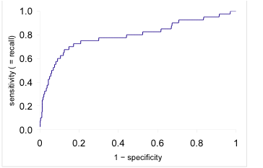
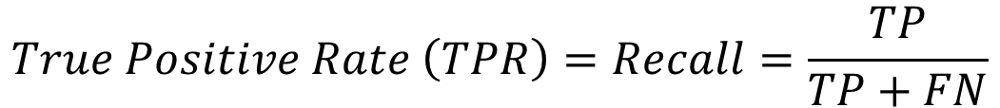
ROC (Receiver Operating Characteristics) Curve
$$True Positive Rate \left(TPR\right)=Recall=\frac{TP}{TP+FN}$$
$$False Positive Rate \left(FPR\right)=1−Specificity=\frac{FP}{TN+FP}$$
ROC curve
  Plotted against TPR and FPR for various threshold values.
Area Under Curve (AUC)
  The area under ROC curve

Slide 10


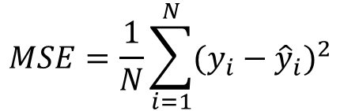
Regression Evaluation Metrics
Mean Absolute Error
  The average of the difference between the Original Values and the Predicted Values.
Sum of Squared Error
Mean Squared Error
$$MAE=\frac{1}{N}\sum_{i=1}^{N}{|y_{i}−{\hat{y}}_{i}|}$$
$$SSE=\sum_{i=1}^{N}{{(y_{i}−{\hat{y}}_{i})}^{2}}$$
$$MSE=\frac{1}{N}\sum_{i=1}^{N}{{(y_{i}−{\hat{y}}_{i})}^{2}}$$

Slide 11
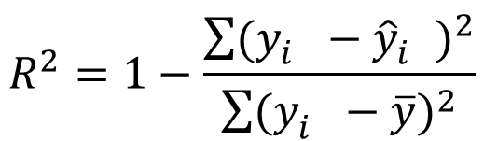

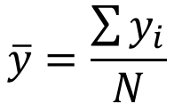
Root Mean Squared Error
  The square root of the average of the square of the difference between the original values and the predicted values.
R² coefficient
$$RMSE=\sqrt{\frac{1}{N}\sum_{i=1}^{N}{{(y_{i}−{\hat{y}}_{i})}^{2}} }$$
$$R^{2}=1−\frac{\sum{{(y_{i}^{}−{\hat{y}}_{i}^{})}^{2}}}{\sum{{(y_{i}^{}−\overline{y})}^{2}}}$$
$$\overline{y}=\frac{\sum{y_{i}}}{N}$$

Slide 12
Evalation Data
Using training data to evaluate performance
  Not useful - because it rewards models that can "remember" the training data, as opposed to generalizing from it.
  Overestimate performance

Slide 13
HoldOut
Test a model on different data than it was trained on.
The dataset is randomly divided into two subsets
  Training set: used to build a predictive model.
  Test set: unseen data. The dataset is used to assess the likely future performance of a model.

Slide 14
If a learning method needs to find best parameters, splite data into training/validation/test dataset
  Validation set: used to assess the performance of the model built in the training phase.

Slide 15
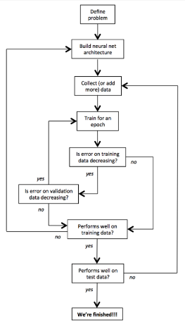
Fundamentals of Deep Learning,
Fig.2-14. Detailed workflow for training and evaluating a deep learning model

Slide 16
Cross-Validation
k-fold cross-validation
  The original dataset is partitioned into k equal size subsamples (folds)
  Repeat k times
    The ith subset is used as the test set, the other k-1 subsets are put together to form a training set.
  The estimation of accuracy is averaged over all k trials to get the total effectiveness of a model.

Slide 17
Leave-one-out cross-validation
  Repeat N times
    The ith sample is used as the test data, the other N-1 samples are put together to form a training set.

